Slide 1

TreeSolutions Group 10
Amélie Buysse
Berre Deleersnijder
Joren Renders
Mathieu Deconinck
Gevorg Sofoyan

Slide 2
Agenda
About the brand
Problem
ERD
Website
Solution
Code structure
Recap
Above and beyond
Q&A session

Slide 3
01 About the brand

Slide 4

Placabois’ problem
Placabois, just like many production companies, had an issue concerning the management of the complaints within the firm.
This is where Treesolutions came in to help. We provided a website that can:
- Keep stock of complaint data
- Be used to manage the lifetime of a complaint
- Help gain valuable insights about complaint data
All while being as applicable as possible for firms.
Placabois insisted on using our site within the whole enterprise group Vanca Group of which they are a part.

Slide 5
Placabois’ User Stories
User | I Want to Action | So that benefit | Prioriteit
Vertegenwoordiger | Inloggen & zichzelf identificeren | De klacht correct aan mijn naam gekoppeld wordt | 1
Vertegenwoordiger | Een klant selecteren/ingeven | De klacht aan de juiste klant/order gelinkt wordt | 1
Vertegenwoordiger | Een klacht registreren (klantgegevens + probleemdetails + foto's uploaden) | Belangrijke info niet verloren gaat en de klacht volledig en correct wordt doorgegeven | 1
General Manager | Een automatische melding ontvangen bij nieuwe klacht | Snel kan beoordelen en prioriteit kan inschatten | 1
General Manager | Een klacht openen en beoordelen (goedkeuren, afwijzen, of doorsturen naar fabrikant) | De juiste interne opvolging kan gebeuren afhankelijk van type klacht | 1
General Manager | Indien nodig klacht als ‘prioritair’ aanduiden | Kritieke klachten sneller verwerkt worden | 1
General Manager | Export van klachten maken (Excel / CSV) | Rapportage & structurele verbeteringen mogelijk maken | 1
Internal Sales/Admin | Een automatische e-mail ontvangen bij goedgekeurde klacht | Ik de klacht kan verwerken in het ERP of opvolgsysteem | 1
Internal Sales/Admin | De status van de klacht kunnen updaten (“in behandeling”, “afgehandeld”, …) | Iedereen altijd zicht heeft op de voortgang van de klacht | 2
IS/GM | Klachten kunnen filteren op klant, categorie, datum en status | Trends te kunnen analyseren en wederkerende problemen op te volgen | 2
As a team we tried to tackle as many of Placabois’ User stories as possible, even going beyond!

Slide 6
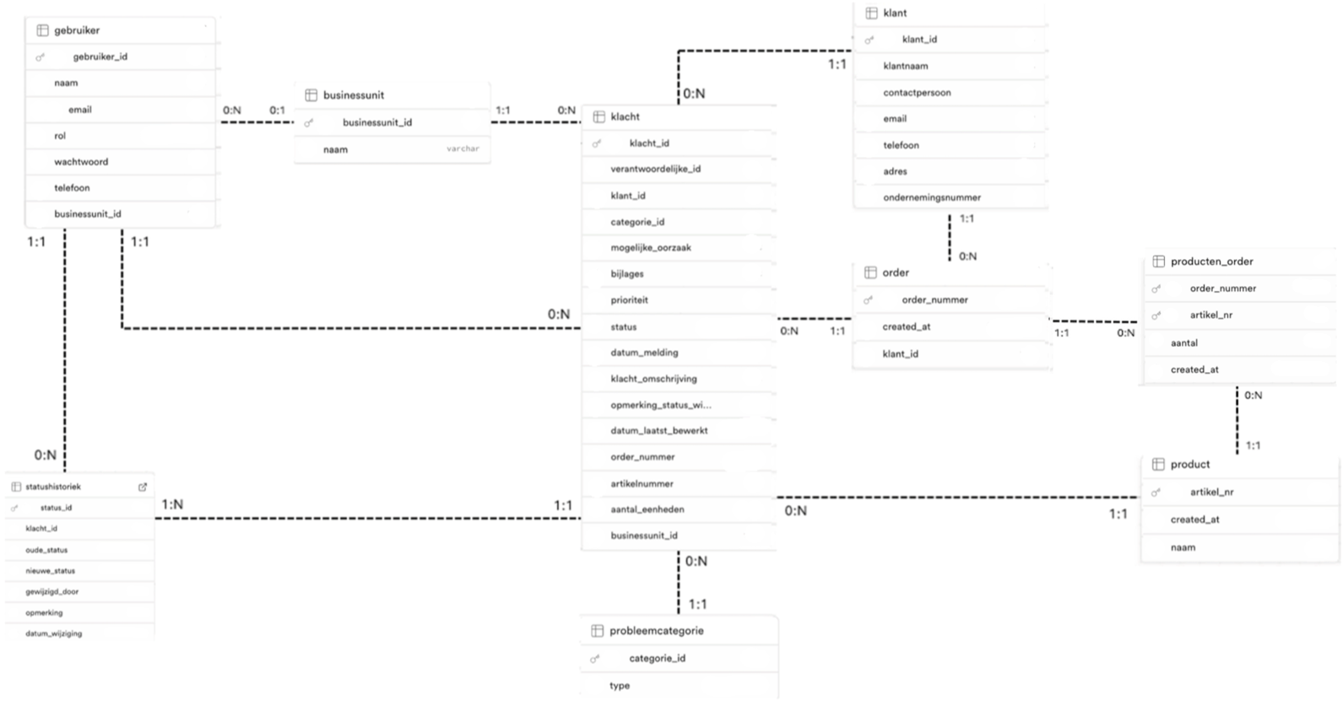
THE DATAMODEL BEHIND OUR SOLUTION

Slide 7
02 Website

Slide 8

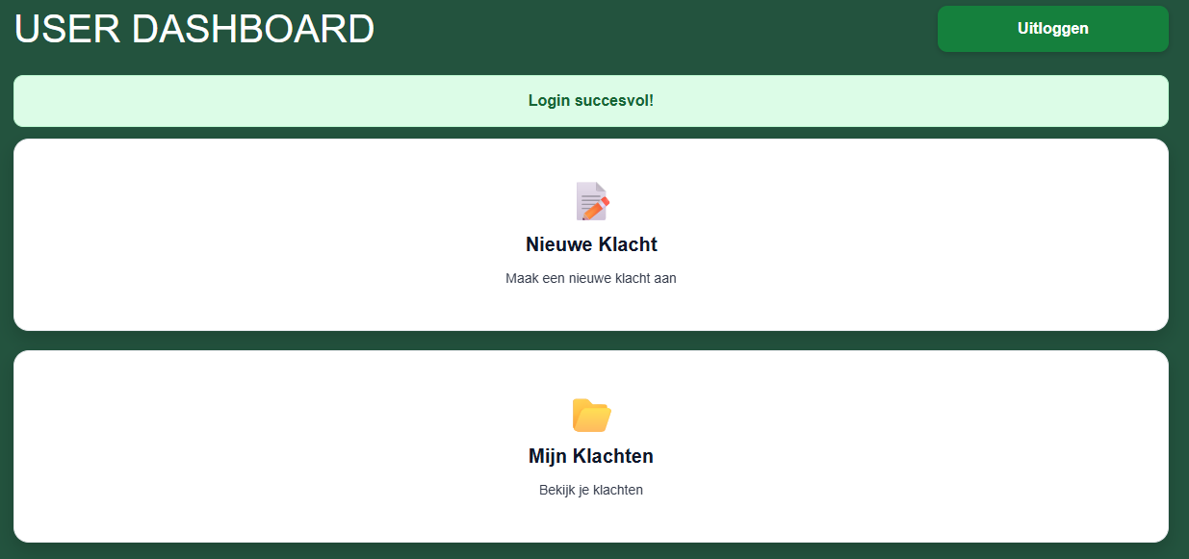
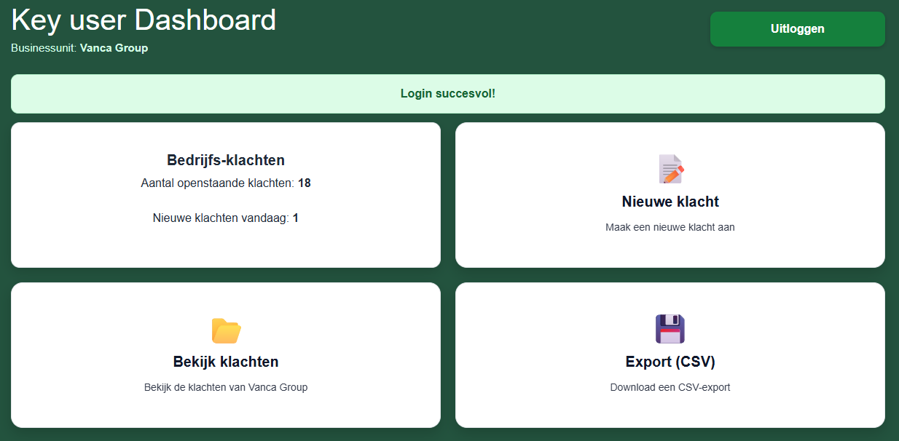
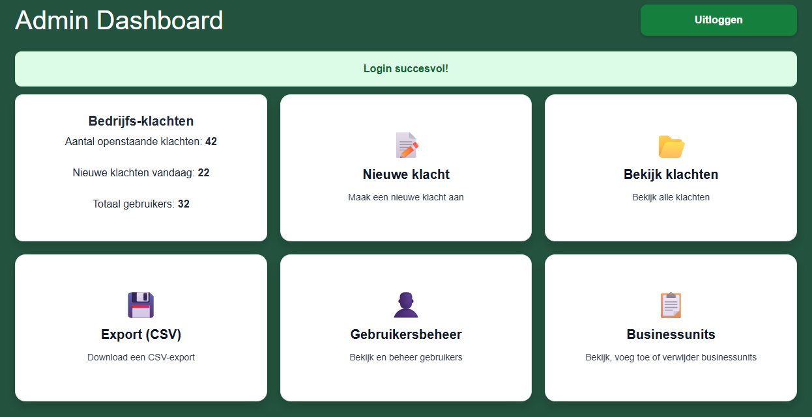
WEBSITE
User
Key User
Admin
*note that we will only elaborate on the admin dashboard in the demo given it includes all functionalities
Notes:
Hier uitleggen wat je allemaal kan doen → User Stories zijn vervuld

Slide 9


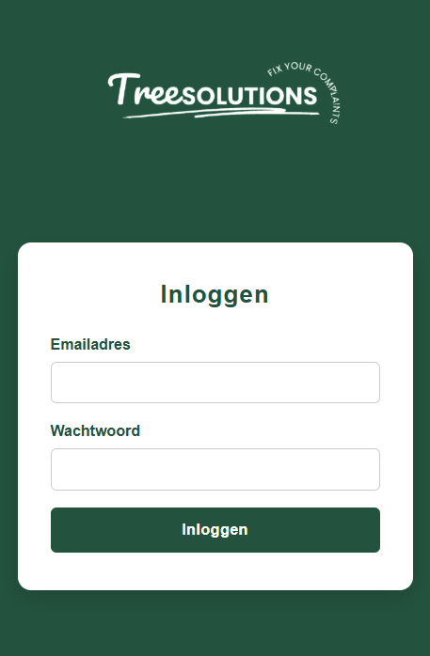


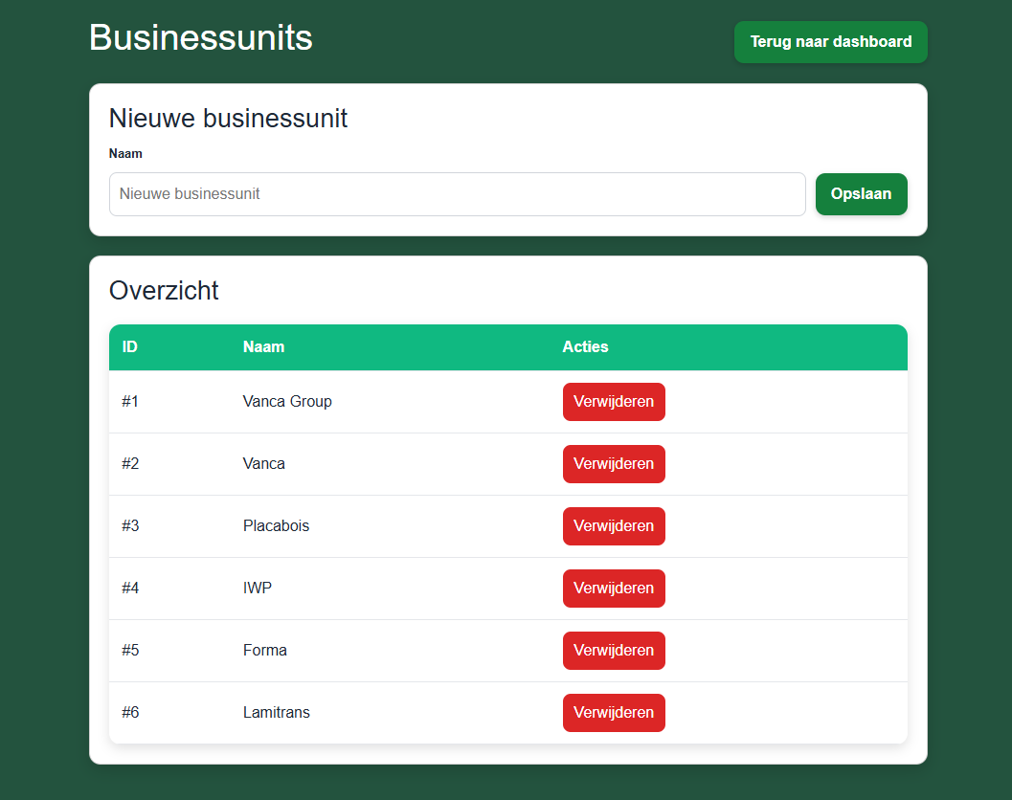
BOOTSTRAP
Designed to be used on phone → for sales workers (users)
SCALABLE
All production companies have quality issues. Either complaints are internal or external, a system keeping and tracking their data and progression is essential.
The “businessunit-system” built into our application is very versatile. A group of corporations can share their data and workers within a platform, a single corporation can have multiple branches, or you can only add one unit and use it as a stand-alone company.
Vanca Group is also looking to scale this website to their entities in the Netherlands. (Short-term scalability)

Slide 10
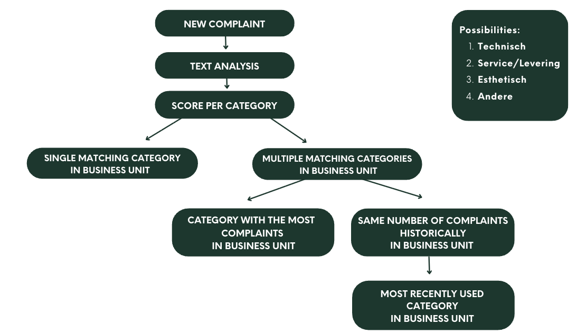
Complex Algorithm:

Slide 11
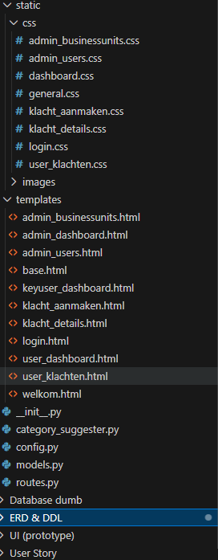
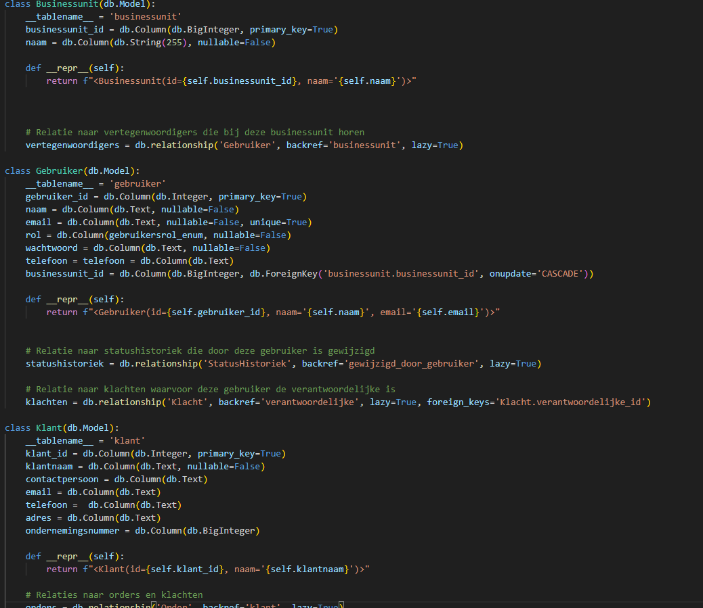
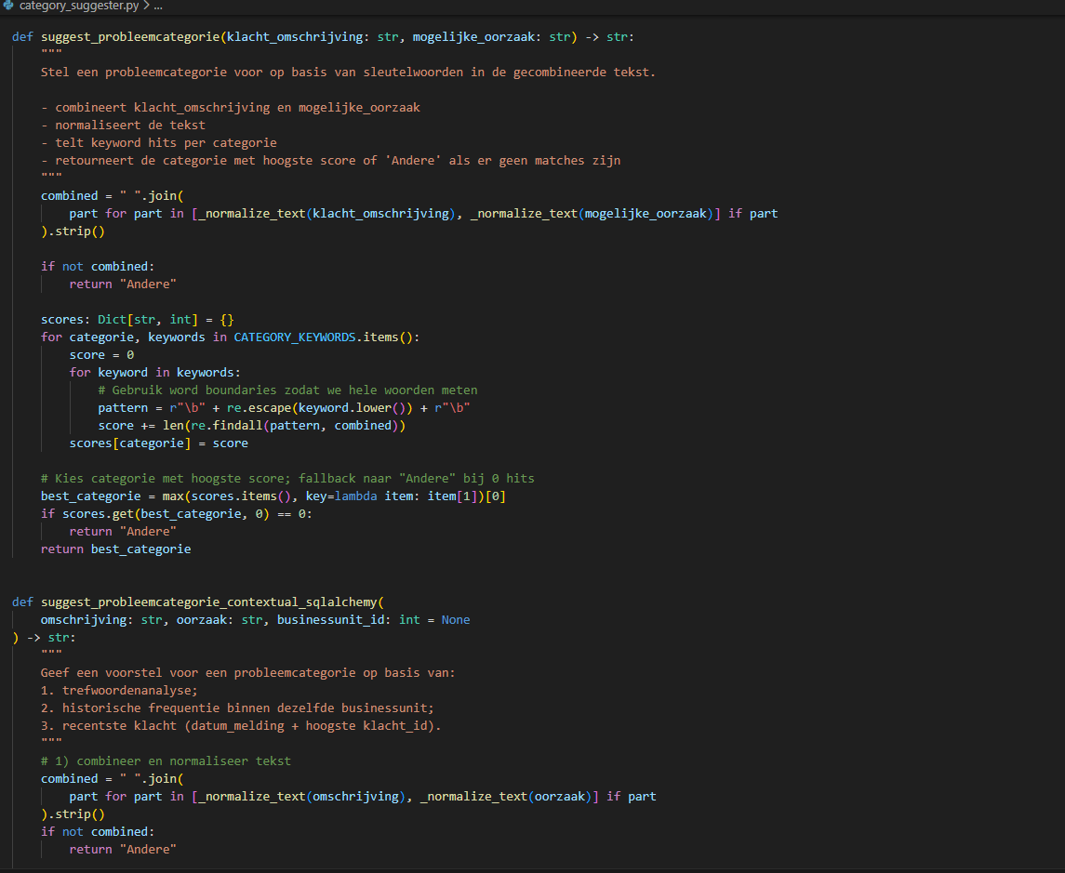
Our Code We took a very structured approach in building our code: - Divided the static and dynamic template files, also using base templates for both - Divided our database and logic in different files, with base functions that are recalled to help with resolving issues -Reused code as much as possible -Created a separate file for the complex algorithm

Slide 12
03 Recap

Slide 13
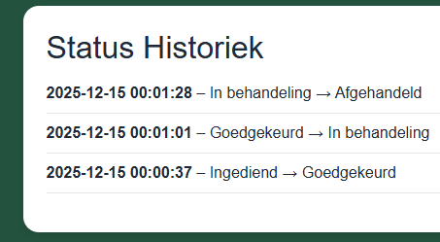
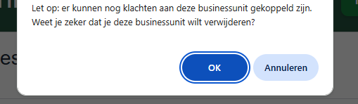
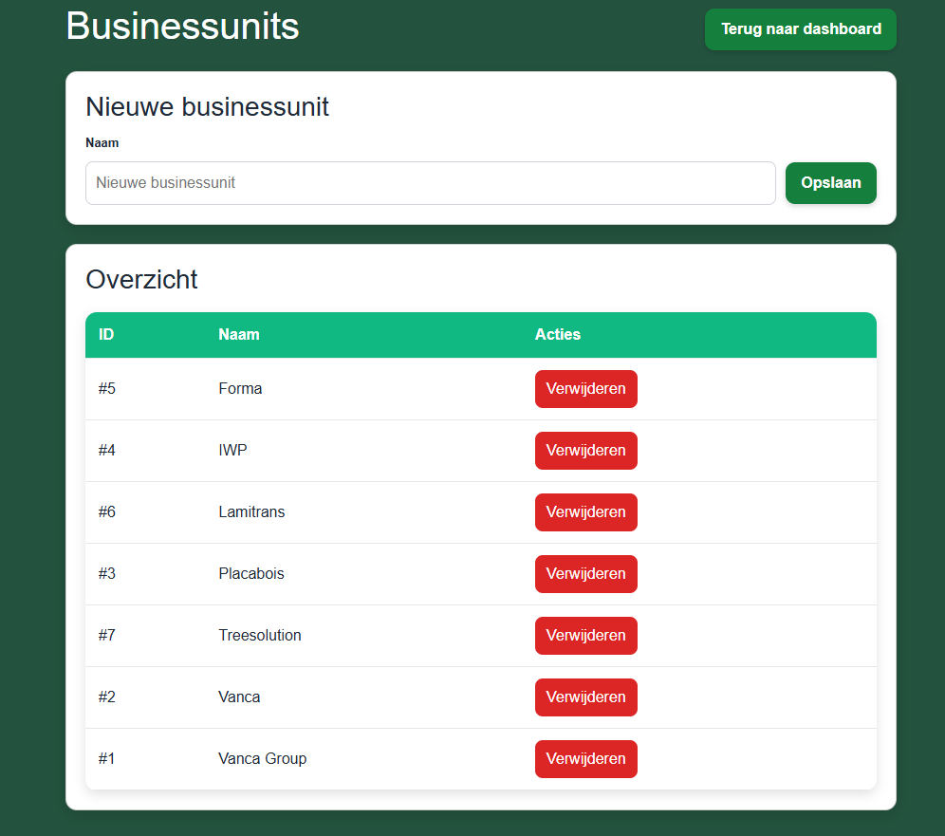
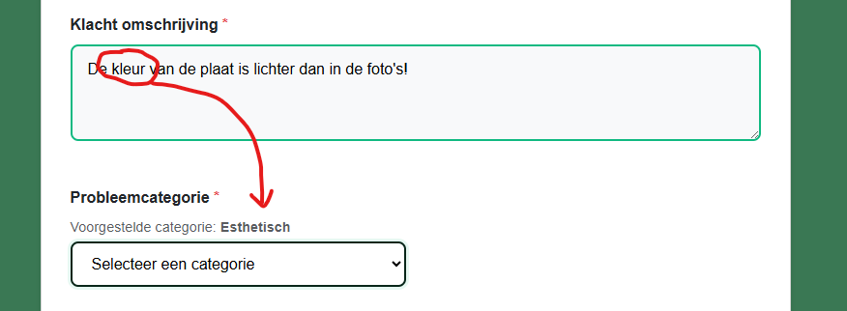
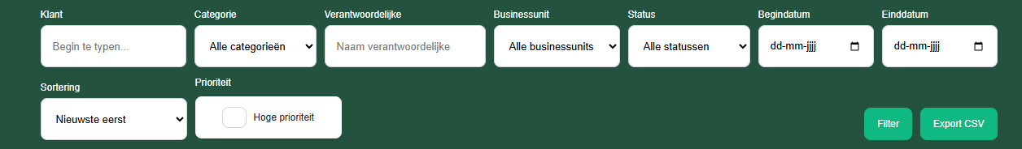
On top of creating a complaint management system fulfilling Vanca Groups Wishes we also went beyond with the following: - Feature to track lifetime of every complaint - Complex complaint auto-assignment - System for keeping form employees deleting data and information - Functional system to divide and distribute complaints to different businessunits - Extensive filtersystem - And much more

Slide 14
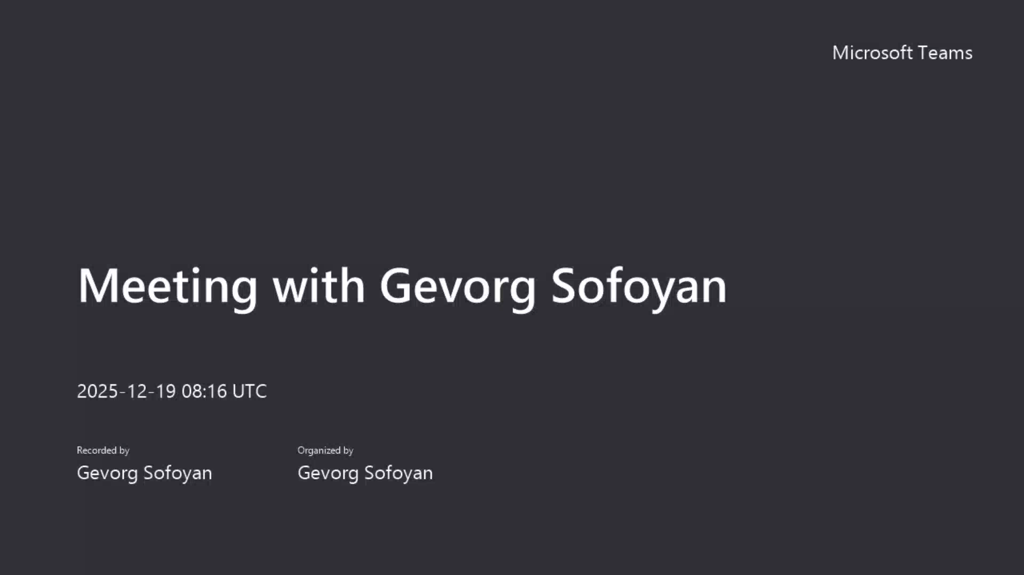
DEMO

Slide 15


Q & A session
Thank you for your attention!

Slide 16
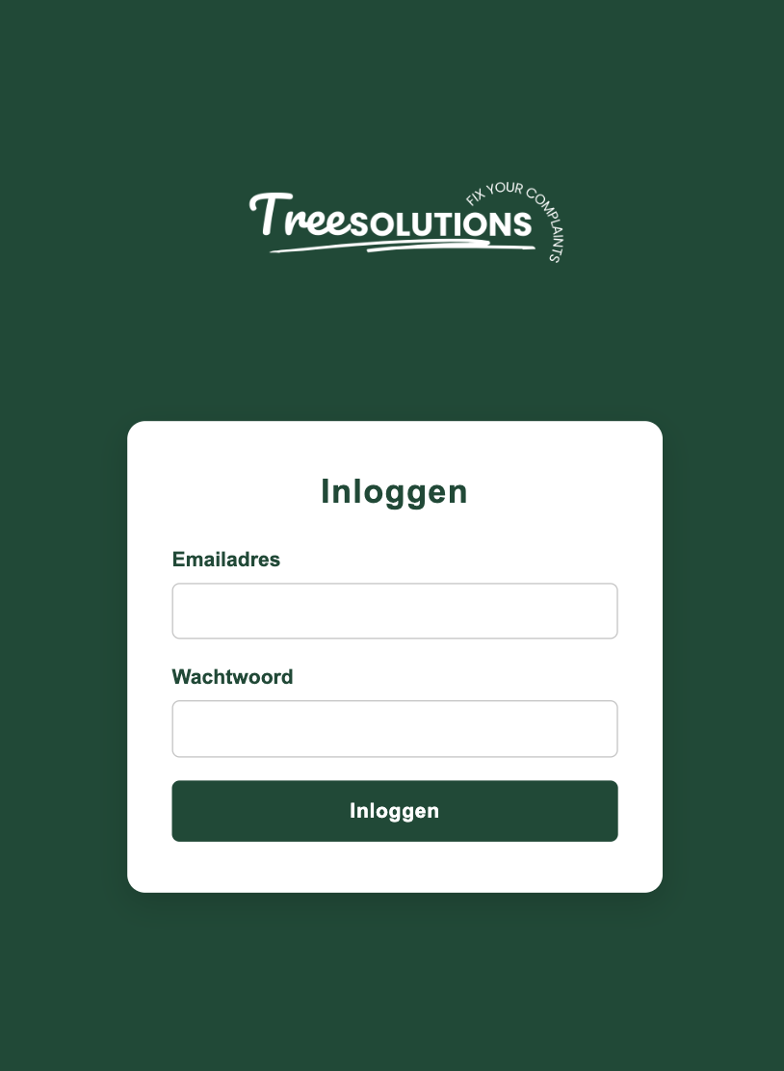
Login Page

Slide 17
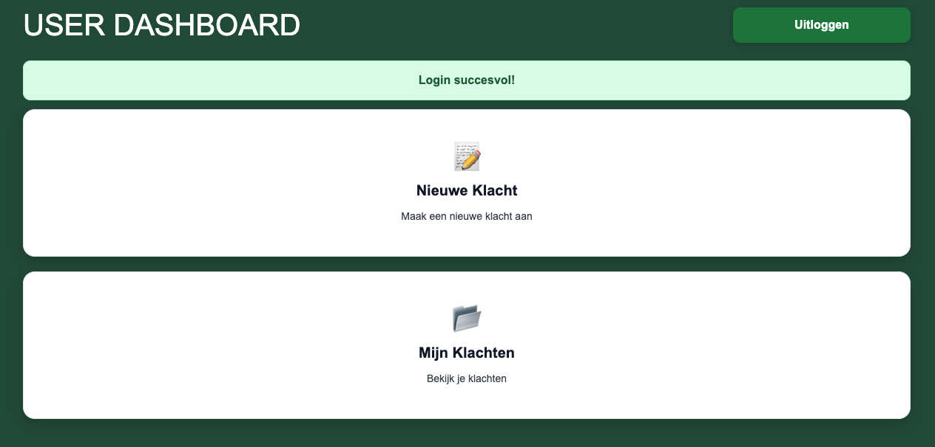
User Dashboard

Slide 18
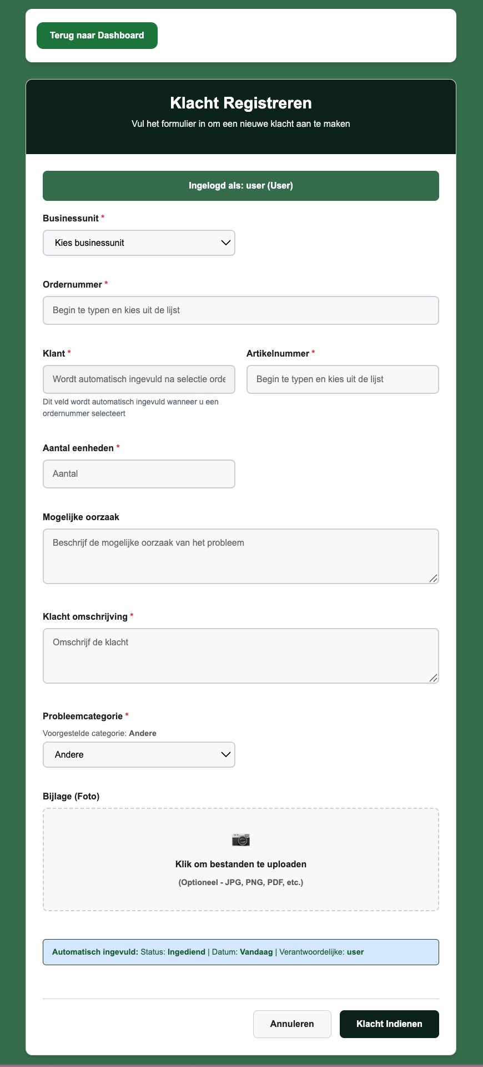
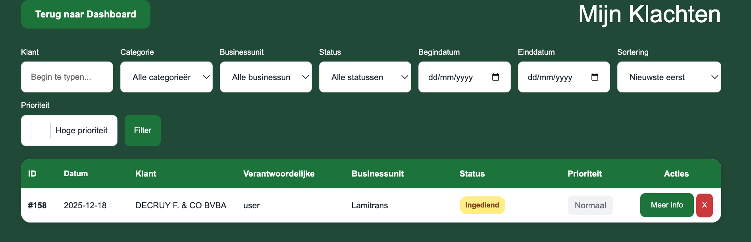

Slide 19
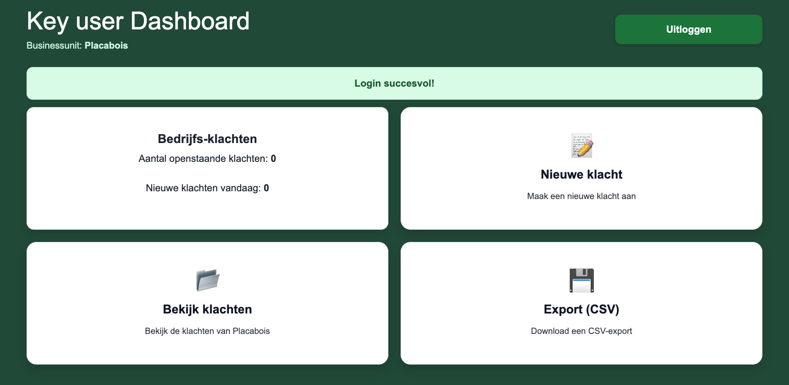
Key User Dashboard

Slide 20
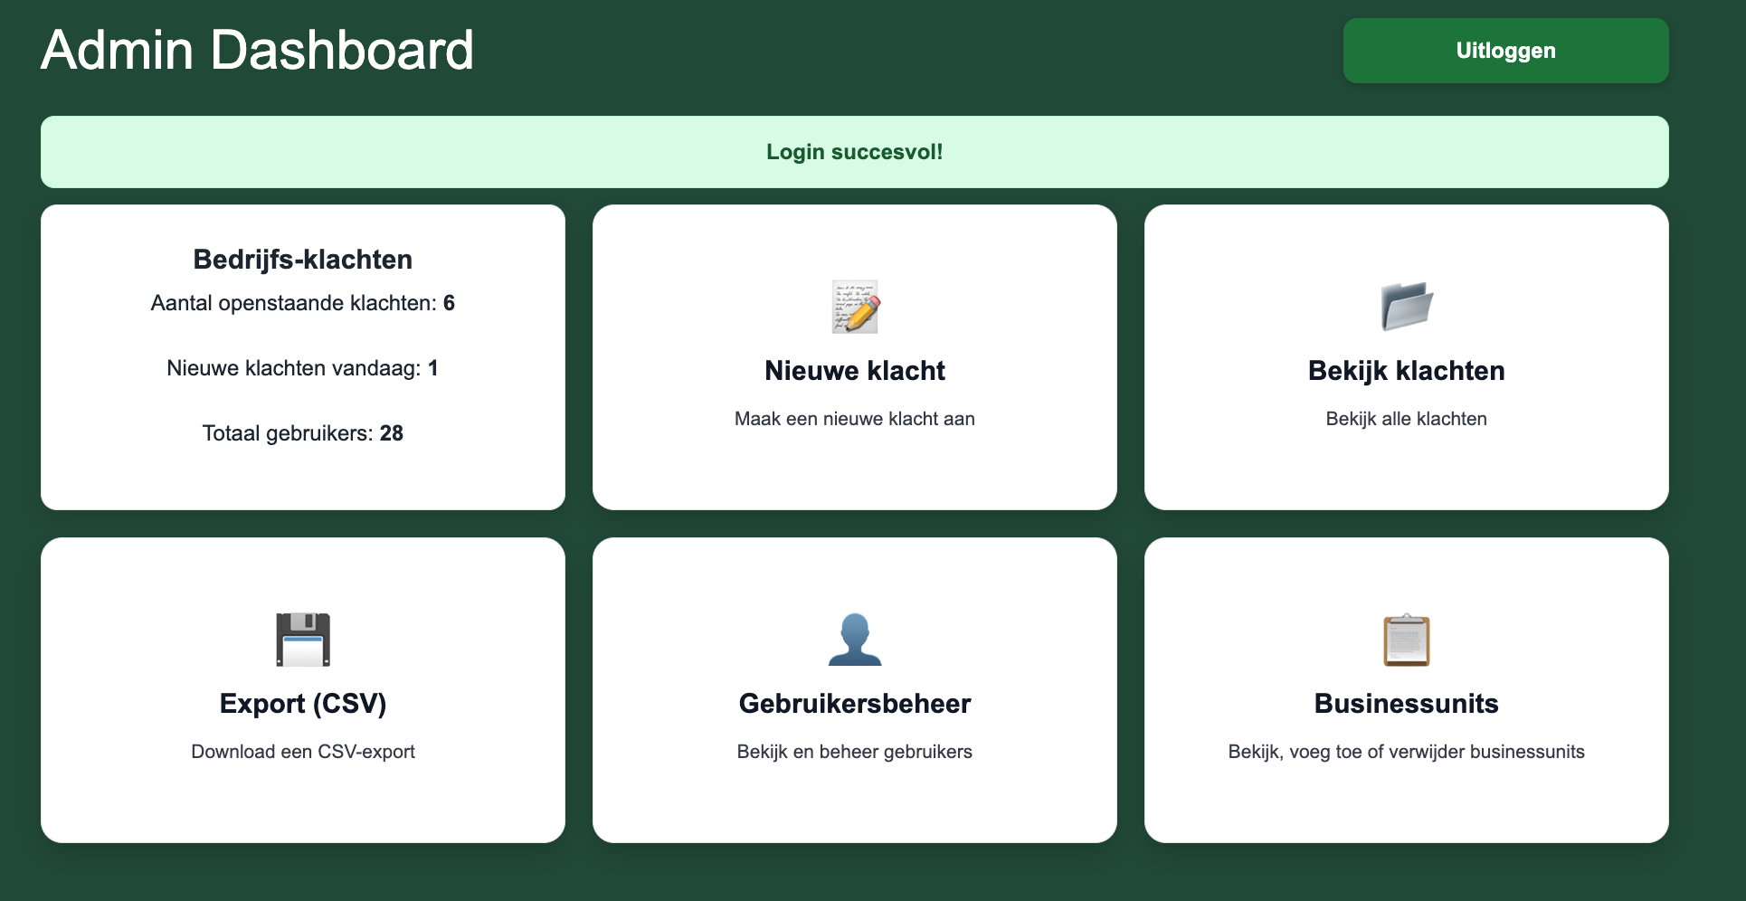
Admin Dashboard

Slide 21
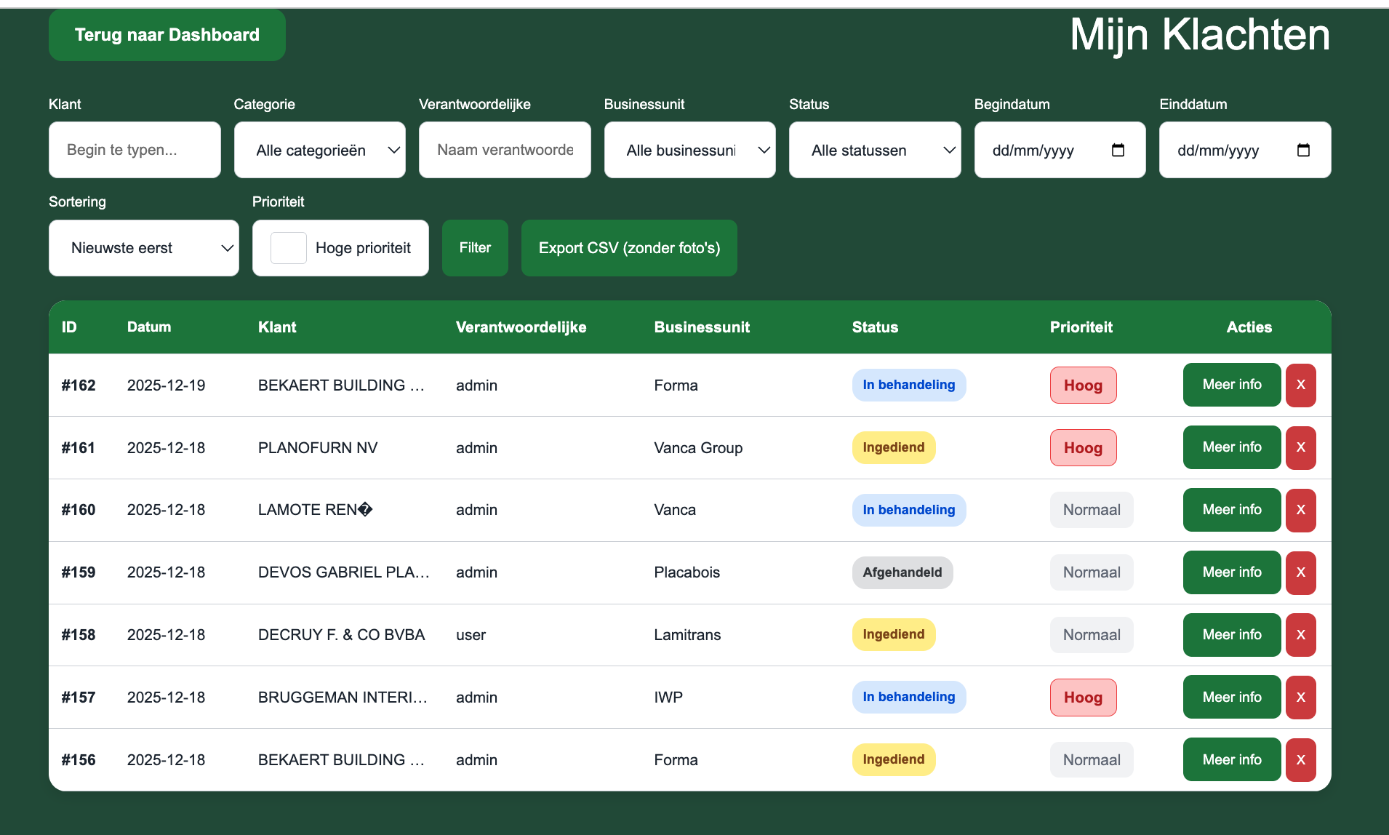

Slide 22
CSV Export
What is in the CVS export?
Klacht ID
Verantwoordelijke ID
Verantwoordelijke Naam
Klant ID
Klantnaam
Ordernummer
Aantal eenheden
Categorie ID (probeemcategorie)
Categorie type
Status
Mogelijke oorzaak
Klacht Omschrijving
Priorteit
Datum melding
Business Unit
Ondernemingsnummer

Slide 23
